Slide 1
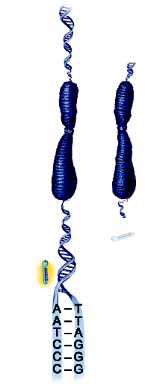
Chromosome
Longer telomere
Short telomere
Effective telomerase
Uneffective telomerase or non present
Telomerase are repetitive sequence of DNA

